Slide 1
I Believe: An Alien Analysis
By: Group 10
Megan Cross, Nate Kelly, Heather Allardice, Melissa Wiese
Elizabeth Pasi Schiffman, and Jocelyn Conard

Slide 2
Motivation (Project Details)
Reported UFO sightings in the United States from 1993-2014
Good dataset to look for patterns, trends, or correlations
Dataset was large enough to accomplish our tasks
A topic that wasn’t controversial yet interesting
Notes:
Why did we choose the topic of reported UFO sightings

Slide 3
The Data Sources
UFO reported sightings .csv from Kaggle.com
Sourced from National UFO Reporting Center (NUFORC)
Google geolocation API
US Census 2010
Notes:
UFO Sightings: https://www.kaggle.com/NUFORC/ufo-sightings?select=scrubbed.csv

Slide 4
Questions
Where are most reported UFO sightings normalized by population
What UFO shape was most frequently sighted
Any change in shape type by region or over time
How long are reported UFO sightings in seconds
Any change in duration of UFO sightings by shape or over time
Are they any correlations between reported UFO sightings and
Population
Sex
Age
Employment by US and armed forces

Slide 5
Data Cleanup & Exploration
Started with .csv file for Kaggle.com
Cleaned and organized the data to bring scope to US from 1993-2014
Converted datetime to Month, Day, and Time
Convert Day to WeekDay
Dropped NA
Added County Data from Google API
Add region data
Add population data from US Census
Plotted sightings on a Map using geopandas

Slide 6
Data Analysis (Insights or Surprizes)
Artifacts and more Artifacts
Spaces
Misspelling
Mistakes in data
County Level data not standardized
Discovered many ways to analyze the data

Slide 7
Data Analysis (Problems)
Different Interpretations or perspectives of the data
Merging the data
Splitting the data
Which questions to keep and which to remove
Dropped unemployment data
Median vs Mean
Used Median due to large outliers
Most problems solved by communicating and Google

Slide 8
Data Analysis (Charts Created)
Map of all reported sightings from 1993 – 2014
Reported sightings by percentage of population in each state
Frequency of UFO shapes reported
Frequency changes in shapes by year
Frequency changes in shape by region
Median duration of reported sightings by year
Median duration of reported sightings by shape
Frequency of UFO sightings by weekday
Frequency of sightings correlated to population
Correlated to employment in armed forces
Correlated to sex
Correlated to median age

Slide 9
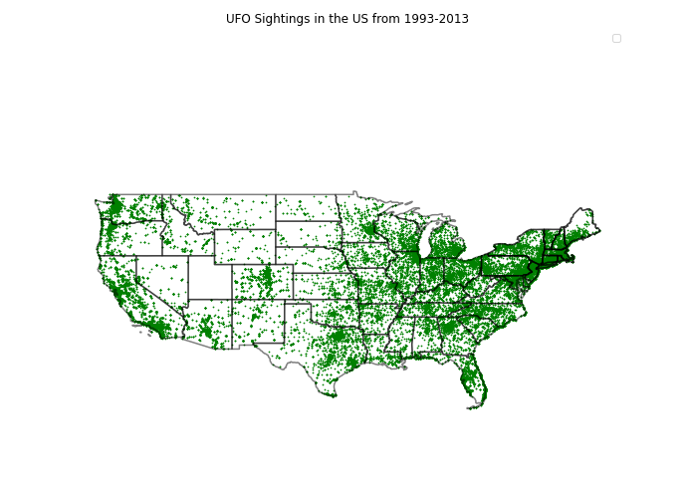

Slide 10
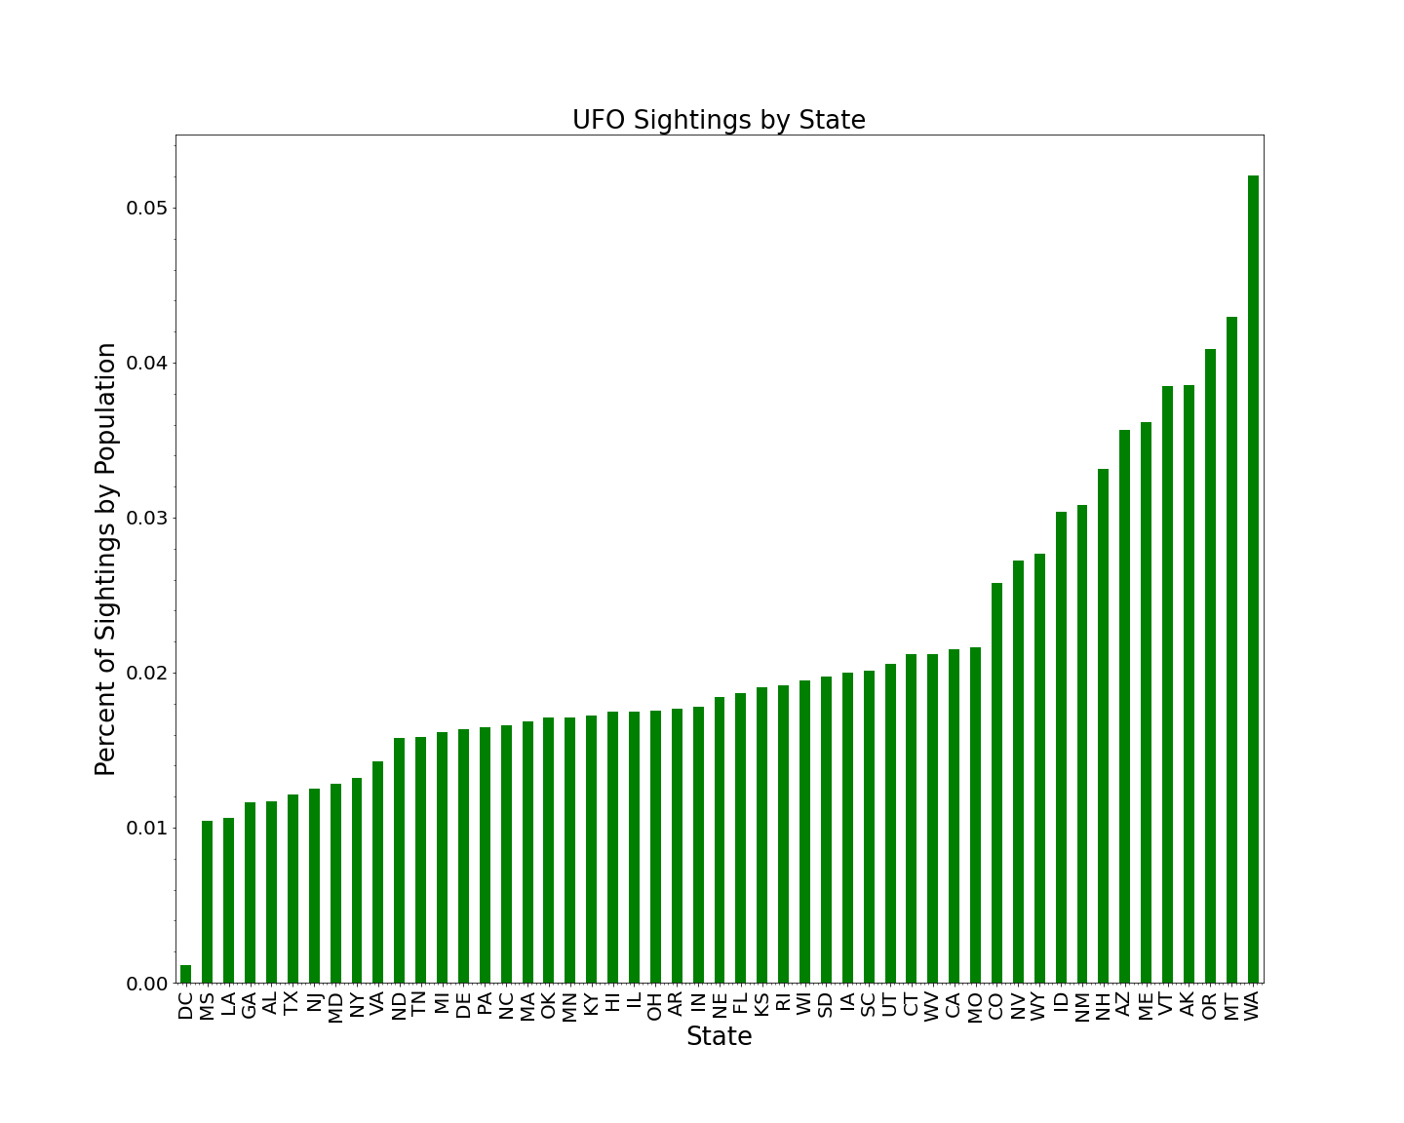

Slide 11
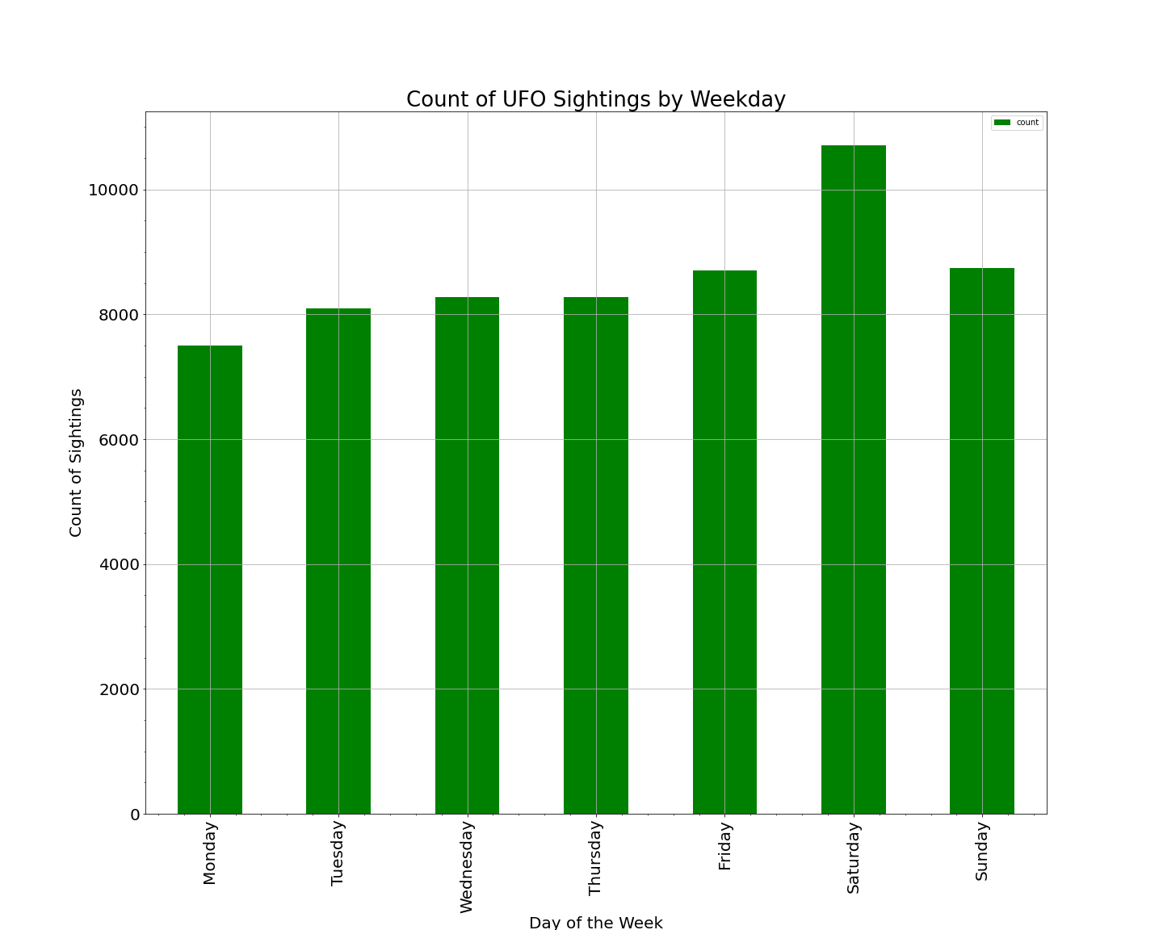

Slide 12
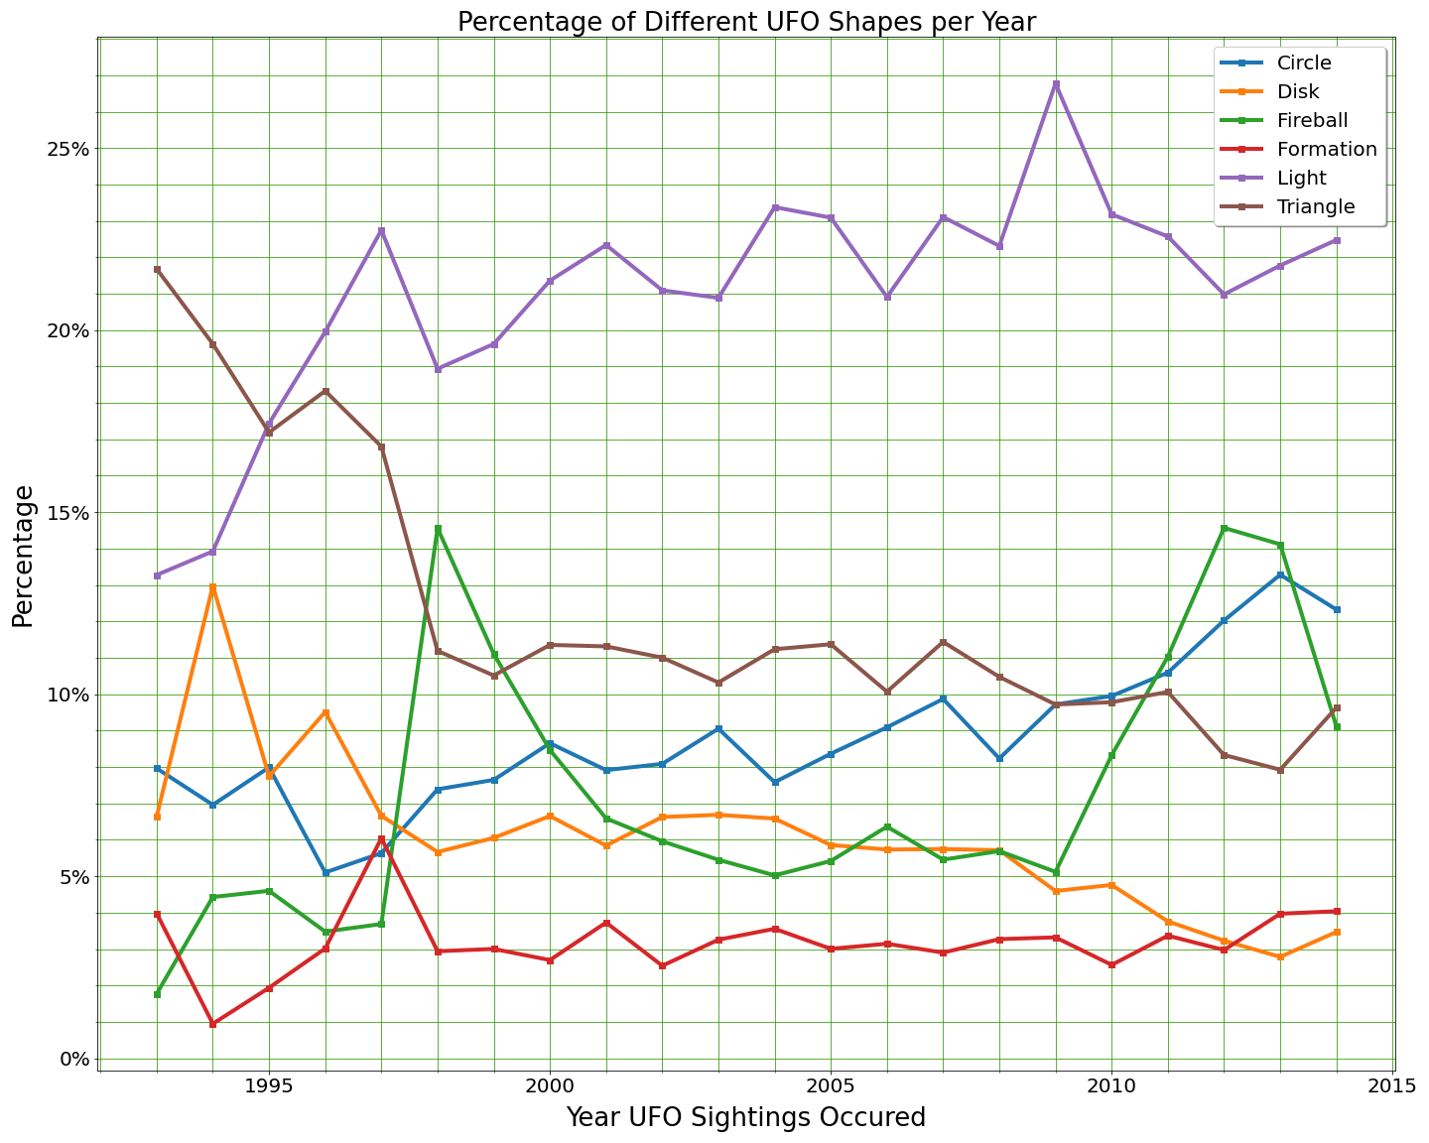

Slide 13
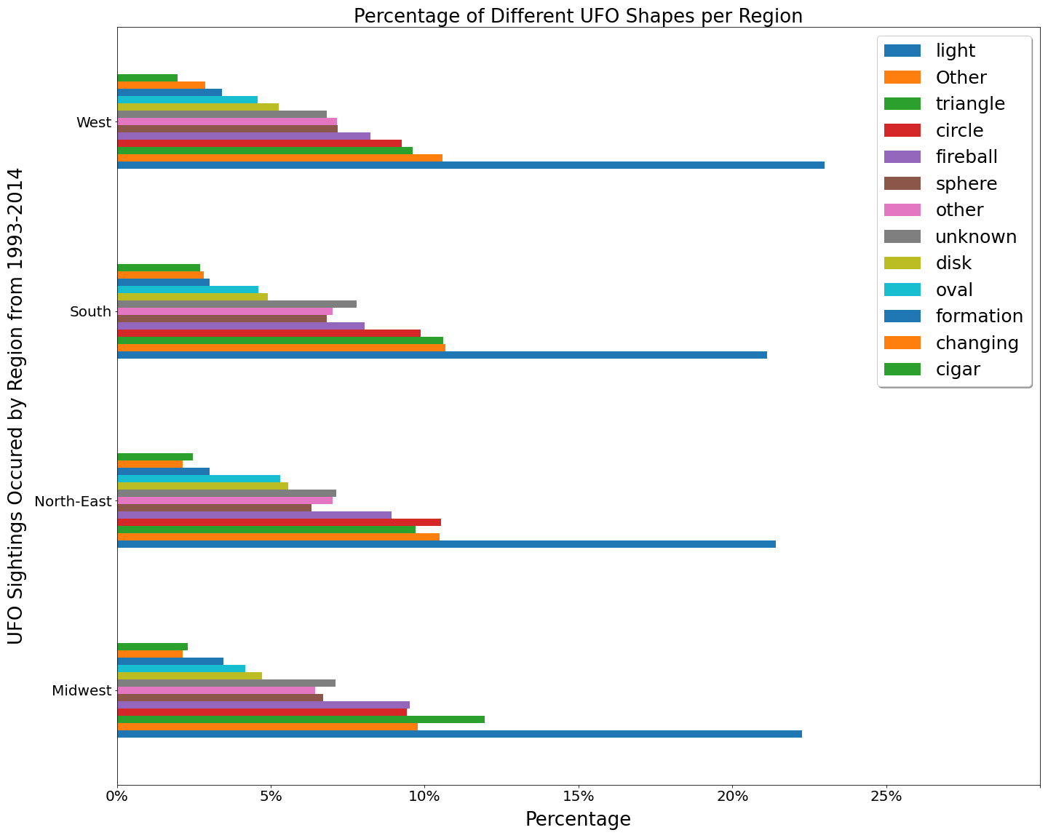

Slide 14
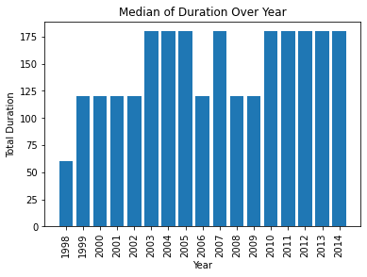

Slide 15
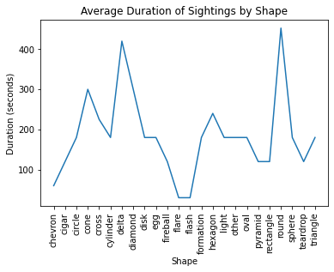

Slide 17
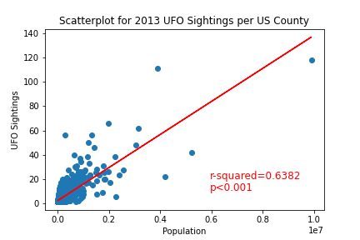

Slide 18
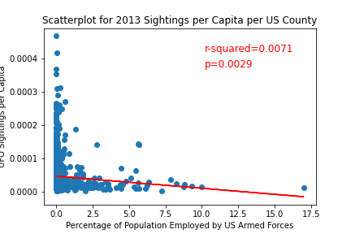

Slide 19
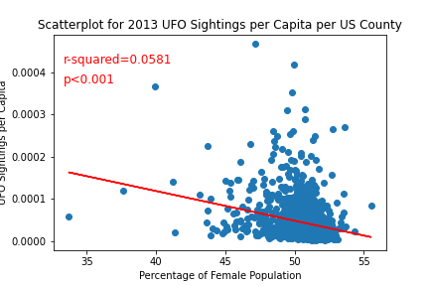

Slide 20
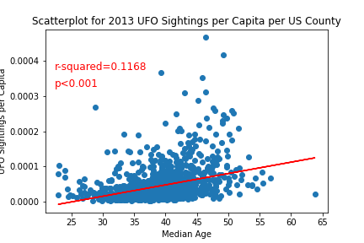

Slide 21
Conclusions

